Slide 1
API 2023 Summit
Report for SEIU Local 1000

Slide 2
Asian Pacific Islanders Caucus Vision
We believe in and will fight for the empowerment of APIs in the labor movement:
–Where API workers are recognized, valued, and respected.
–Where socioeconomic and political power is built and cultivated by APIs.
–Where APIs lead.
–Where APIs are represented in Union leadership bodies and shape the vision and decisions advanced by our Union
–Where we leave a stronger, better and more inclusive movement for generations to come.

Slide 3
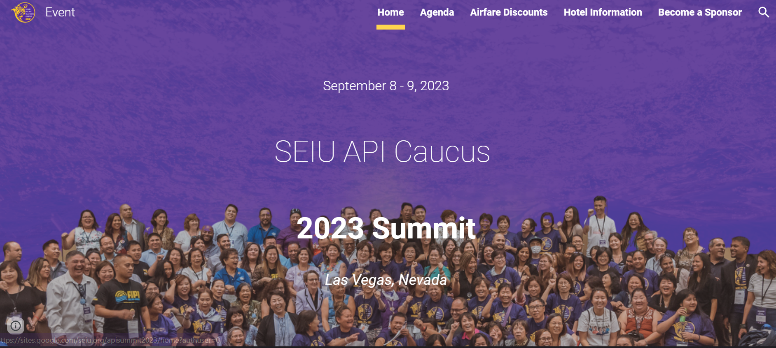
INTRODUCTION
Event website: https://sites.google.com/seiu.org/apisummit2023/home?authuser=0

Slide 4
Summary Report
The 2023 API Summit was a huge success in Las Vegas, Nevada on Thursday, September 7th through Sunday, September 9th. We had over 340+ attendees from across the United States and Canada. We had translation for multiple API languages as well as all signs and printed material in language as well.

Slide 5
SEIU API Platform
•Organizing (Unions for All)
•Politics (Expand Electorate)
•Immigration
•Racial and Economic Justice
•Environmental Justice
•Leadership Development
•Strengthen Our Union
•Language Justice

Slide 6
BREAKOUT SESSIONS
Although I was a facilitator and was not able to participate in the different workshops, our local 1000 team broke up and were strategic in making sure that each person took participated in different workshops so that we would be able to bring bag what we learned to our local.
Racial Justice:
Where do YOU belong?
Unlocking the power in you
Together We Rise:
Being an API leader
Our role in building a stronger union
Bargaining for the next generation
Organizing: Building Resilience

Slide 7
BREAKOUT SESSIONS CONTINUED…
Climate Justice: Organizing for Climate Justice
Political & Civic Engangement:
API Voters Count
Powering API Civic Engagement in a changing political landscape
Members running for elected office
Organizing:
Telling your story is telling the API story
Your Leadership Stance
Building resilience
Leadership Development: Build a TEAM, build a COMMUNITY
Recenter yourself: Tai Chi
Immigration Justice: Our legal rights

Slide 9
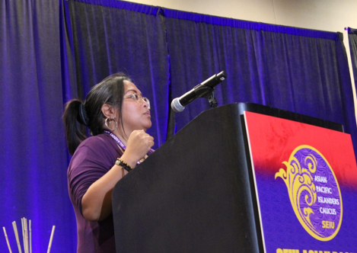

Slide 10
LOCAL 1000 Attendees
Christina Calugcugan
Lindsay Cho
Keilani Laso
Sam Lieu
Kimberly Manuel
Cynthia Vo

Slide 11
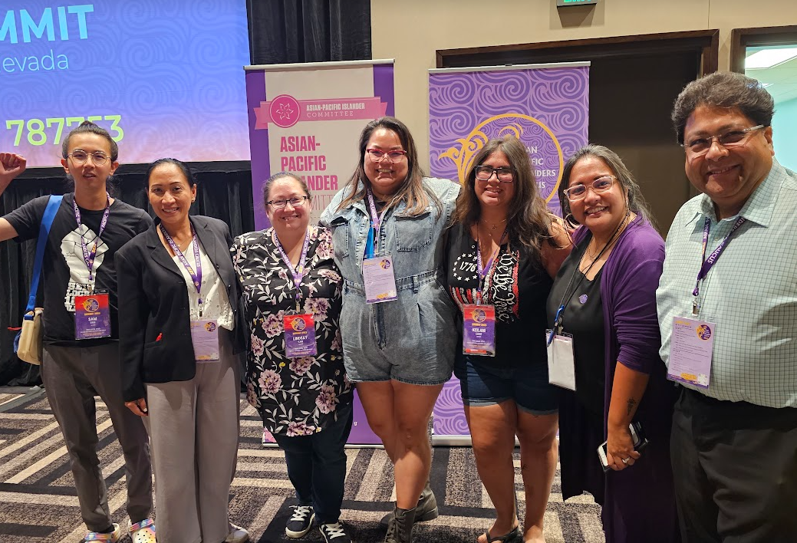
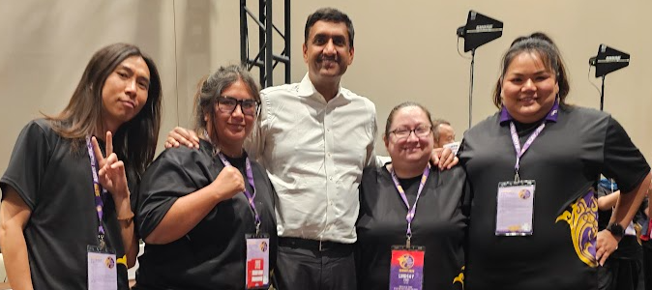

Slide 12
Report from Member, Lindsay Cho (Central Valley)
I am thankful to have been invited to attend the 2023 API Summit in Las Vegas. It is so great that SEIU invests in developing its API leaders through these types of events that included workshops and discussions focusing on leadership development, strengthening our union, organizing, politics, racial and economic justice, environmental justice and fighting for the issues that are important to API members and their families. There was so much culture and knowledge shared throughout the event with the attendees as well as the guest speakers and hosts that can be taken back to our own locals. The API Summit was an experience that will continue to inspire me to work with our local to grow our regional caucus API membership.

Slide 13
Report from Member, Keilani Laso (Central Valley)
The API summit was an interesting experience. As I listened to each individual’s background I received insight on how simple interactions differ between cultures. I was particularly interested in a discussions that was about eye contact. Traditional American culture views eye contact as a sign of respect, but in many Asian cultures can be viewed as hostile. I reflected on many of my interactions with Asian colleagues who refused to look me in the eye and I personally dismissed these individuals by deeming them “weak”.
I think conversations about diversity is needed in our workplaces and by sharing our cultural backgrounds we have the ability establish that baseline of respect.
I particularly enjoyed the section of the summit where we discussed alliance with the Latino and Black communities to further strengthen ourselves as marginalized communities.
THAT is the exact type dialogue we need to have with one another if we are to overcome
many of workplace prejudices.

Slide 14
Report from Member, Sam Lieu (Sacramento)
The 2023 API conference was my first time meeting other locals in the formal capacity. It was also the first professional event that required live translation. The combination of which created an atmosphere internationalism, but heavily confined to SEIU characteristics. I was surprised when realized I was talking to a lot of staff, as opposed to members. Being from a now formerly member-led local, I couldn’t help but think staff were pulling their members along for a not so transparent agenda instead of developing members who they see have leadership potential.
Our local occupies a unique position in the labor movement - we facilitate the 3rd or 4th largest economy in the world. With that potential, it is important to develop member-leaders and their class consciousness, so we don’t end up parroting without critical thinking the harmful line of labor-peace, middle class, etc. But specifically, we must identify and develop API leaders in our local so we can hold the already established API leaders accountable when those leaders go along with harmful ideas like the “middle class” and “anti-asian hate”. Anti-Asian hate is just the latest iteration of the model minority myth. While we can stand in solidarity with other ethnicities by saying it’s racism that’s increasing these attacks on us, instead we’re going with anti-asian hate, which the politicians have taken and made into a bill that increases funding to police. This example is the most glaring, but there are many other more nuanced problems that occur when we buy into the capitalist class’ so-called solutions instead of organizing as a class.

Slide 15
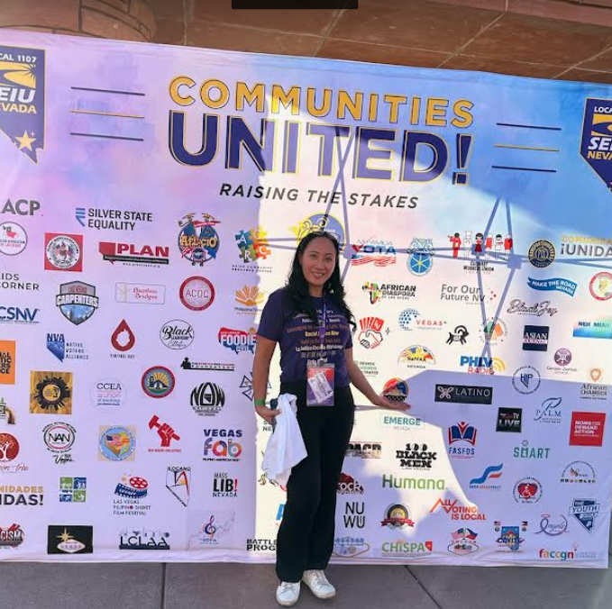
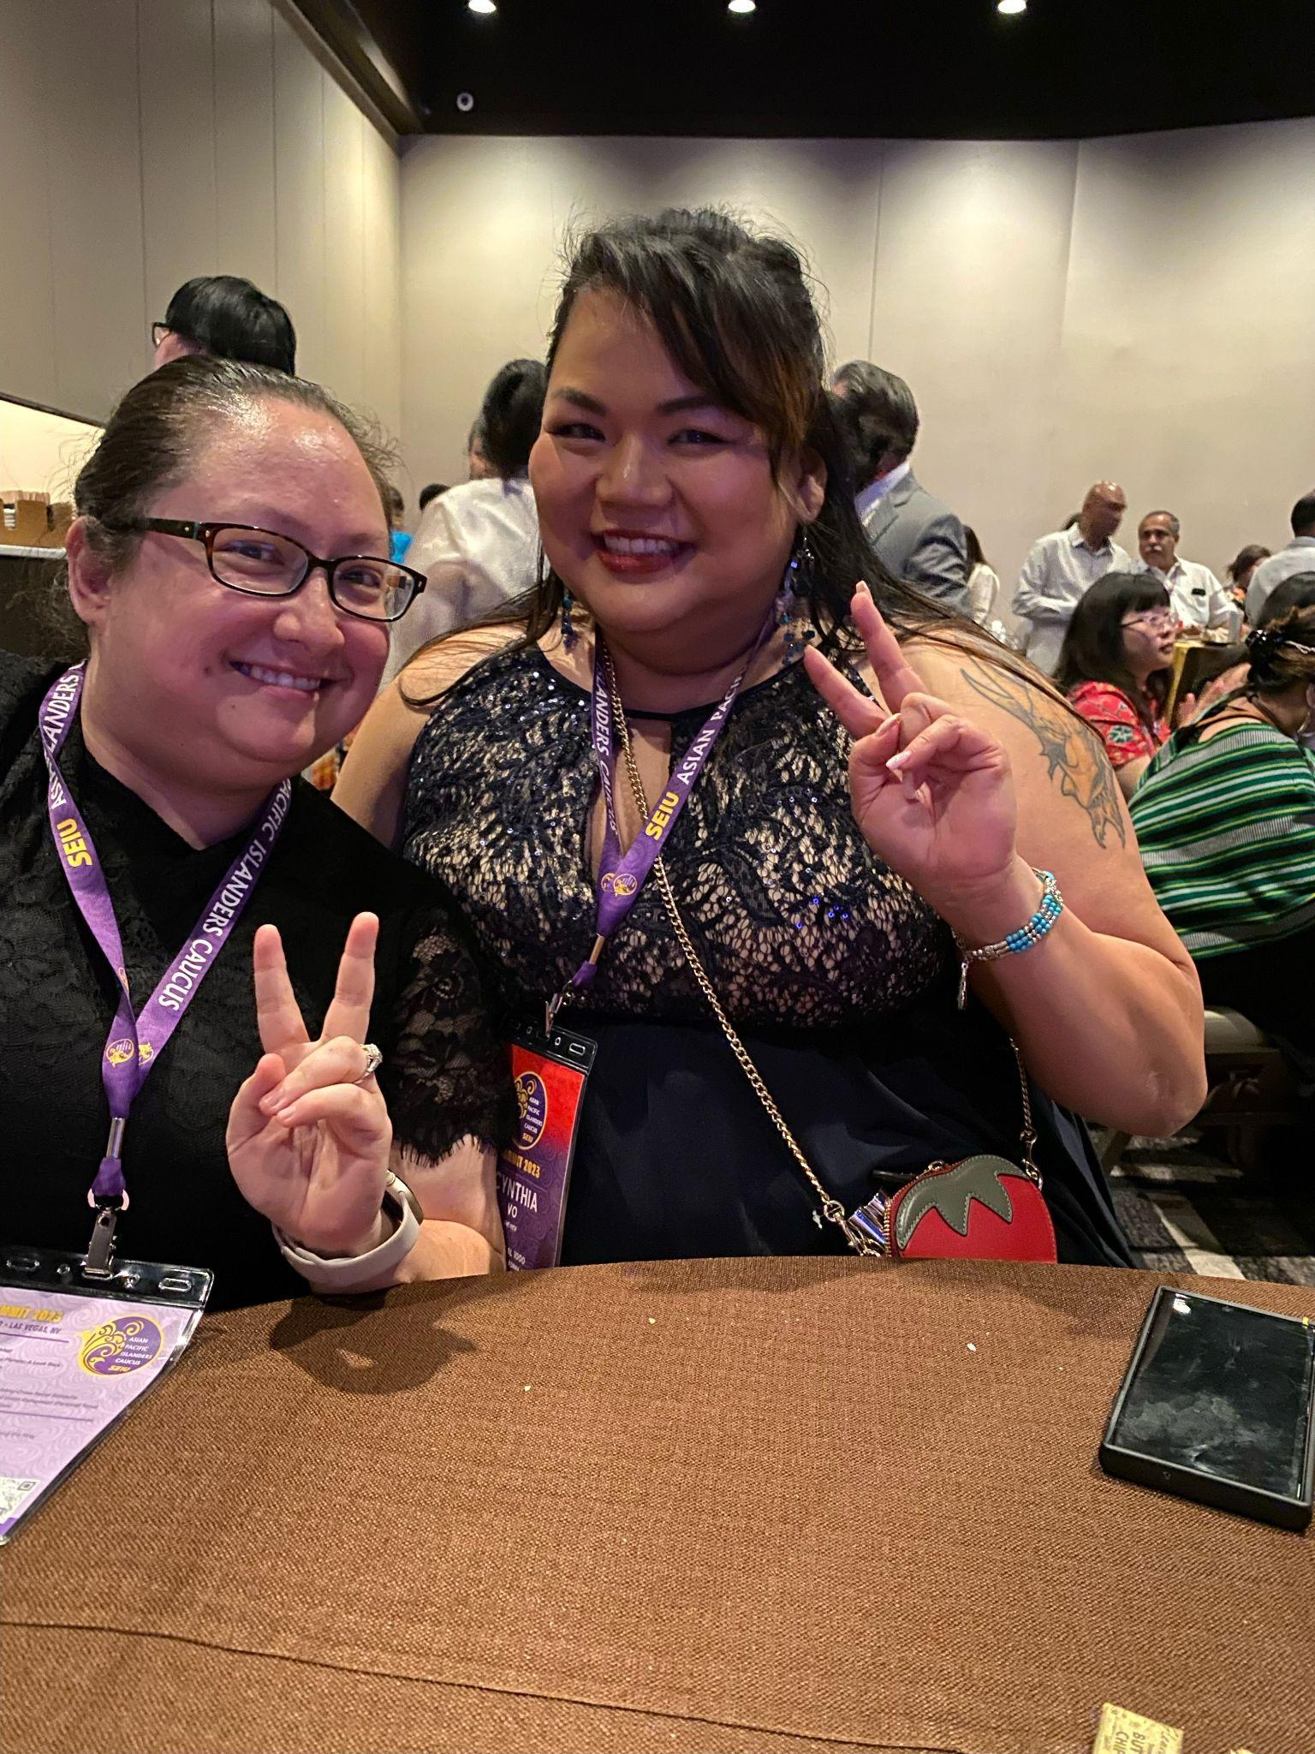
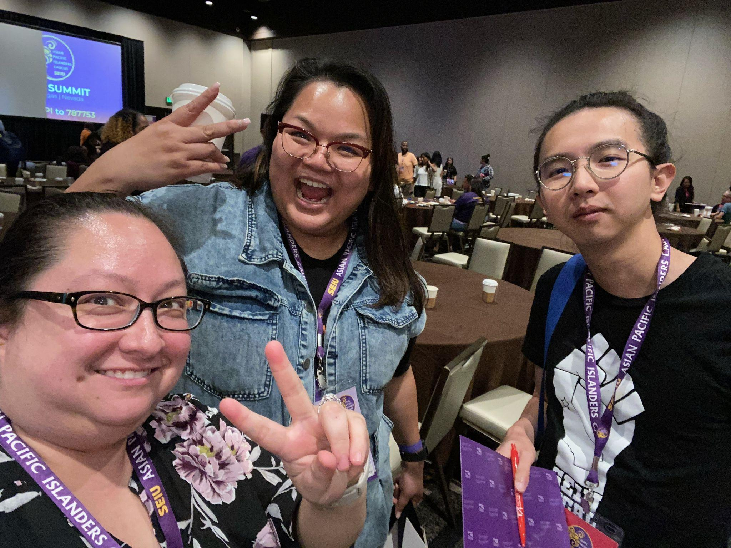

Slide 16
Report from Member, Kimberly Manuel (San Diego)
I am so privileged to be invited to attend this 2023 SEIU API Caucus summit held in Las Vegas last September. I have been an active steward since 2007 and have not heard about the API Committee until Christina Calugcugan had reached out to me about it. I didn’t think twice to attend despite my busy schedule as a mom of 3 kids and a nurse.
During the 2 day event, I have learned so much about SEIU API including its mission and vision , meeting and connecting with fellow Asian members from different locals and sharing rich experiences learning from each other. What I like the most was attending the workshop- Together we Rise; Bargaining for the next Contract where different leaders from other locals shared their success and their fight to win a good contract for their members. This has inspired me so much and pushed me to have a goal of joining the bargaining team next contract negotiations. The Summit Gala was also fun and diverse where our members get to showcase talents and very nice rich cultural outfits.
The two days went by too fast. I have connected and shared numbers with fellow Filipino locals from New York, San Diego, Oregon and Ventura. I have also met fellow Asian UHW caregivers / members from Los Angeles who were very passionate building API power. They are all very inspiring and I want to do the same.
Building and developing API leader in Local 1000 starts with me. This is very important goal to pursue to increase Asian representation in my community and surrounding counties. In my DLC alone, I have identified several Asian members and non members who I will connect in the very near future. I will engage them to participate so together, we can build Power, strengthen our API member and lead the way for a brighter future.

Slide 17
Report from Member, Cynthia Vo (Oakland)
The SEIU API Caucus summit continues to be one of the most impactful union events in my time as a union steward, a Vietnamese American, and a political activist. When I first saw fellow member leader Joel Chan move a 14 story building into concerted action, I was stunned. My union, full of Asian American workers, immigrant workers, comfortable in their civil service while bemoaning the office politics and management, could be empowered. By someone who looked like me. At my first SEIU API Summit, I was awestruck. Slackjawed, I was in a conference room that felt welcoming, and possessed fellow AAPI unionists that were ENTHUSIASTIC about the fight for healthcare, environment, anti-black racism, and the importance of voting in politics. Topics that I wholly endeared. The return to an in-person summit was a family reunion that reinvigorated my messaging, to speak genuinely about AAPI's part in our labor movement. Hearing my family's story coming from another Vietnamese steward realized the false claim that "my story doesn't mean much to others." The connections I made at this summit have been some of my strongest for organizing nationwide, and the keynote speakers are incredibly moving. Each summit has doubled in attendance, with faces young and old,
and foster cascading mentorship, showing that AAPI union leaders are one of the
greatest strengths to grow our labor movement.

Slide 18
