Slide 1
Change
Change is part of life; it happens whether we want to change or not and it can bring out strong emotions. Some people are very resistant to change and that is understandable because there is comfort in the familiar. There are many kinds of change that we will touch on in this article.
Change of Direction
Earlier this year the membership voted to elect a new President. After 13-years the membership wanted change. We can all speculate why this happened but the “why” is not important, the fact is the majority of dues paying members, who voted, wanted a change in leadership. Organizational change is a normal part of the democratic process.
We highlighted above that resistance to change is a natural human reaction, defiance to change in an organization like Local 1000 can be problematic. Some of the problems within our labor organization have been written about and expressed before so there is no need to travel that same ground again.
However, we do need to make one very critical connection as it relates to change. There is a small group within the Board of Directors who are very resistant to change and are desperately trying to return to the status quo. They made a personal assessment, within six-weeks, that the membership was incorrect in the election and a change in leadership was not warranted.
Change Out of Necessity
We are in a whole new dynamic since COVID. For many of our union brothers and sisters the way we work, where we work, and how we interact have all changed. Old processes are having to adjust to this new environment, and we must recognize that continuing to cling to the status quo no longer provides any benefit to our organization or its represented employees.
Recently, the statewide leadership correctly assessed the organizational model that had been used for years to attract new members is no longer applicable in this new paradigm. Local 1000 is working to change to a representational model by providing new resources and training so that we can strengthen and grow our union once again. This means members can expect their union will be there to support and represent them in the workplace when they need it.
Positive Change
A quote often attributed to Albert Einstein states “The definition of insanity is doing the same thing over-and-over and expecting a different result.” President Richard Louis Brown recognizes that if we are to survive as a viable organization we must adapt to this new environment. Failing to alter our approach or desperately clinging to the status quo is not an option.
The amount of time and energy being expended in resisting progress, fighting change, and vetoing the membership vote is not change, its negative movement. We no longer cling to a negative energy that seeks to drag us backward to where we came from, that is why we have elections.
Change is human, it challenges us to grow and make it better. Change forces us to adapt to new situations and problem solve. We must develop new ideas and strategies to meet the environment and not shrink when faced with change. President Brown has promised a new culture in our union, one that is built on positive energy and a positive direction.
Welcome to a new day.

Slide 2
www.calcsea.org

Slide 3
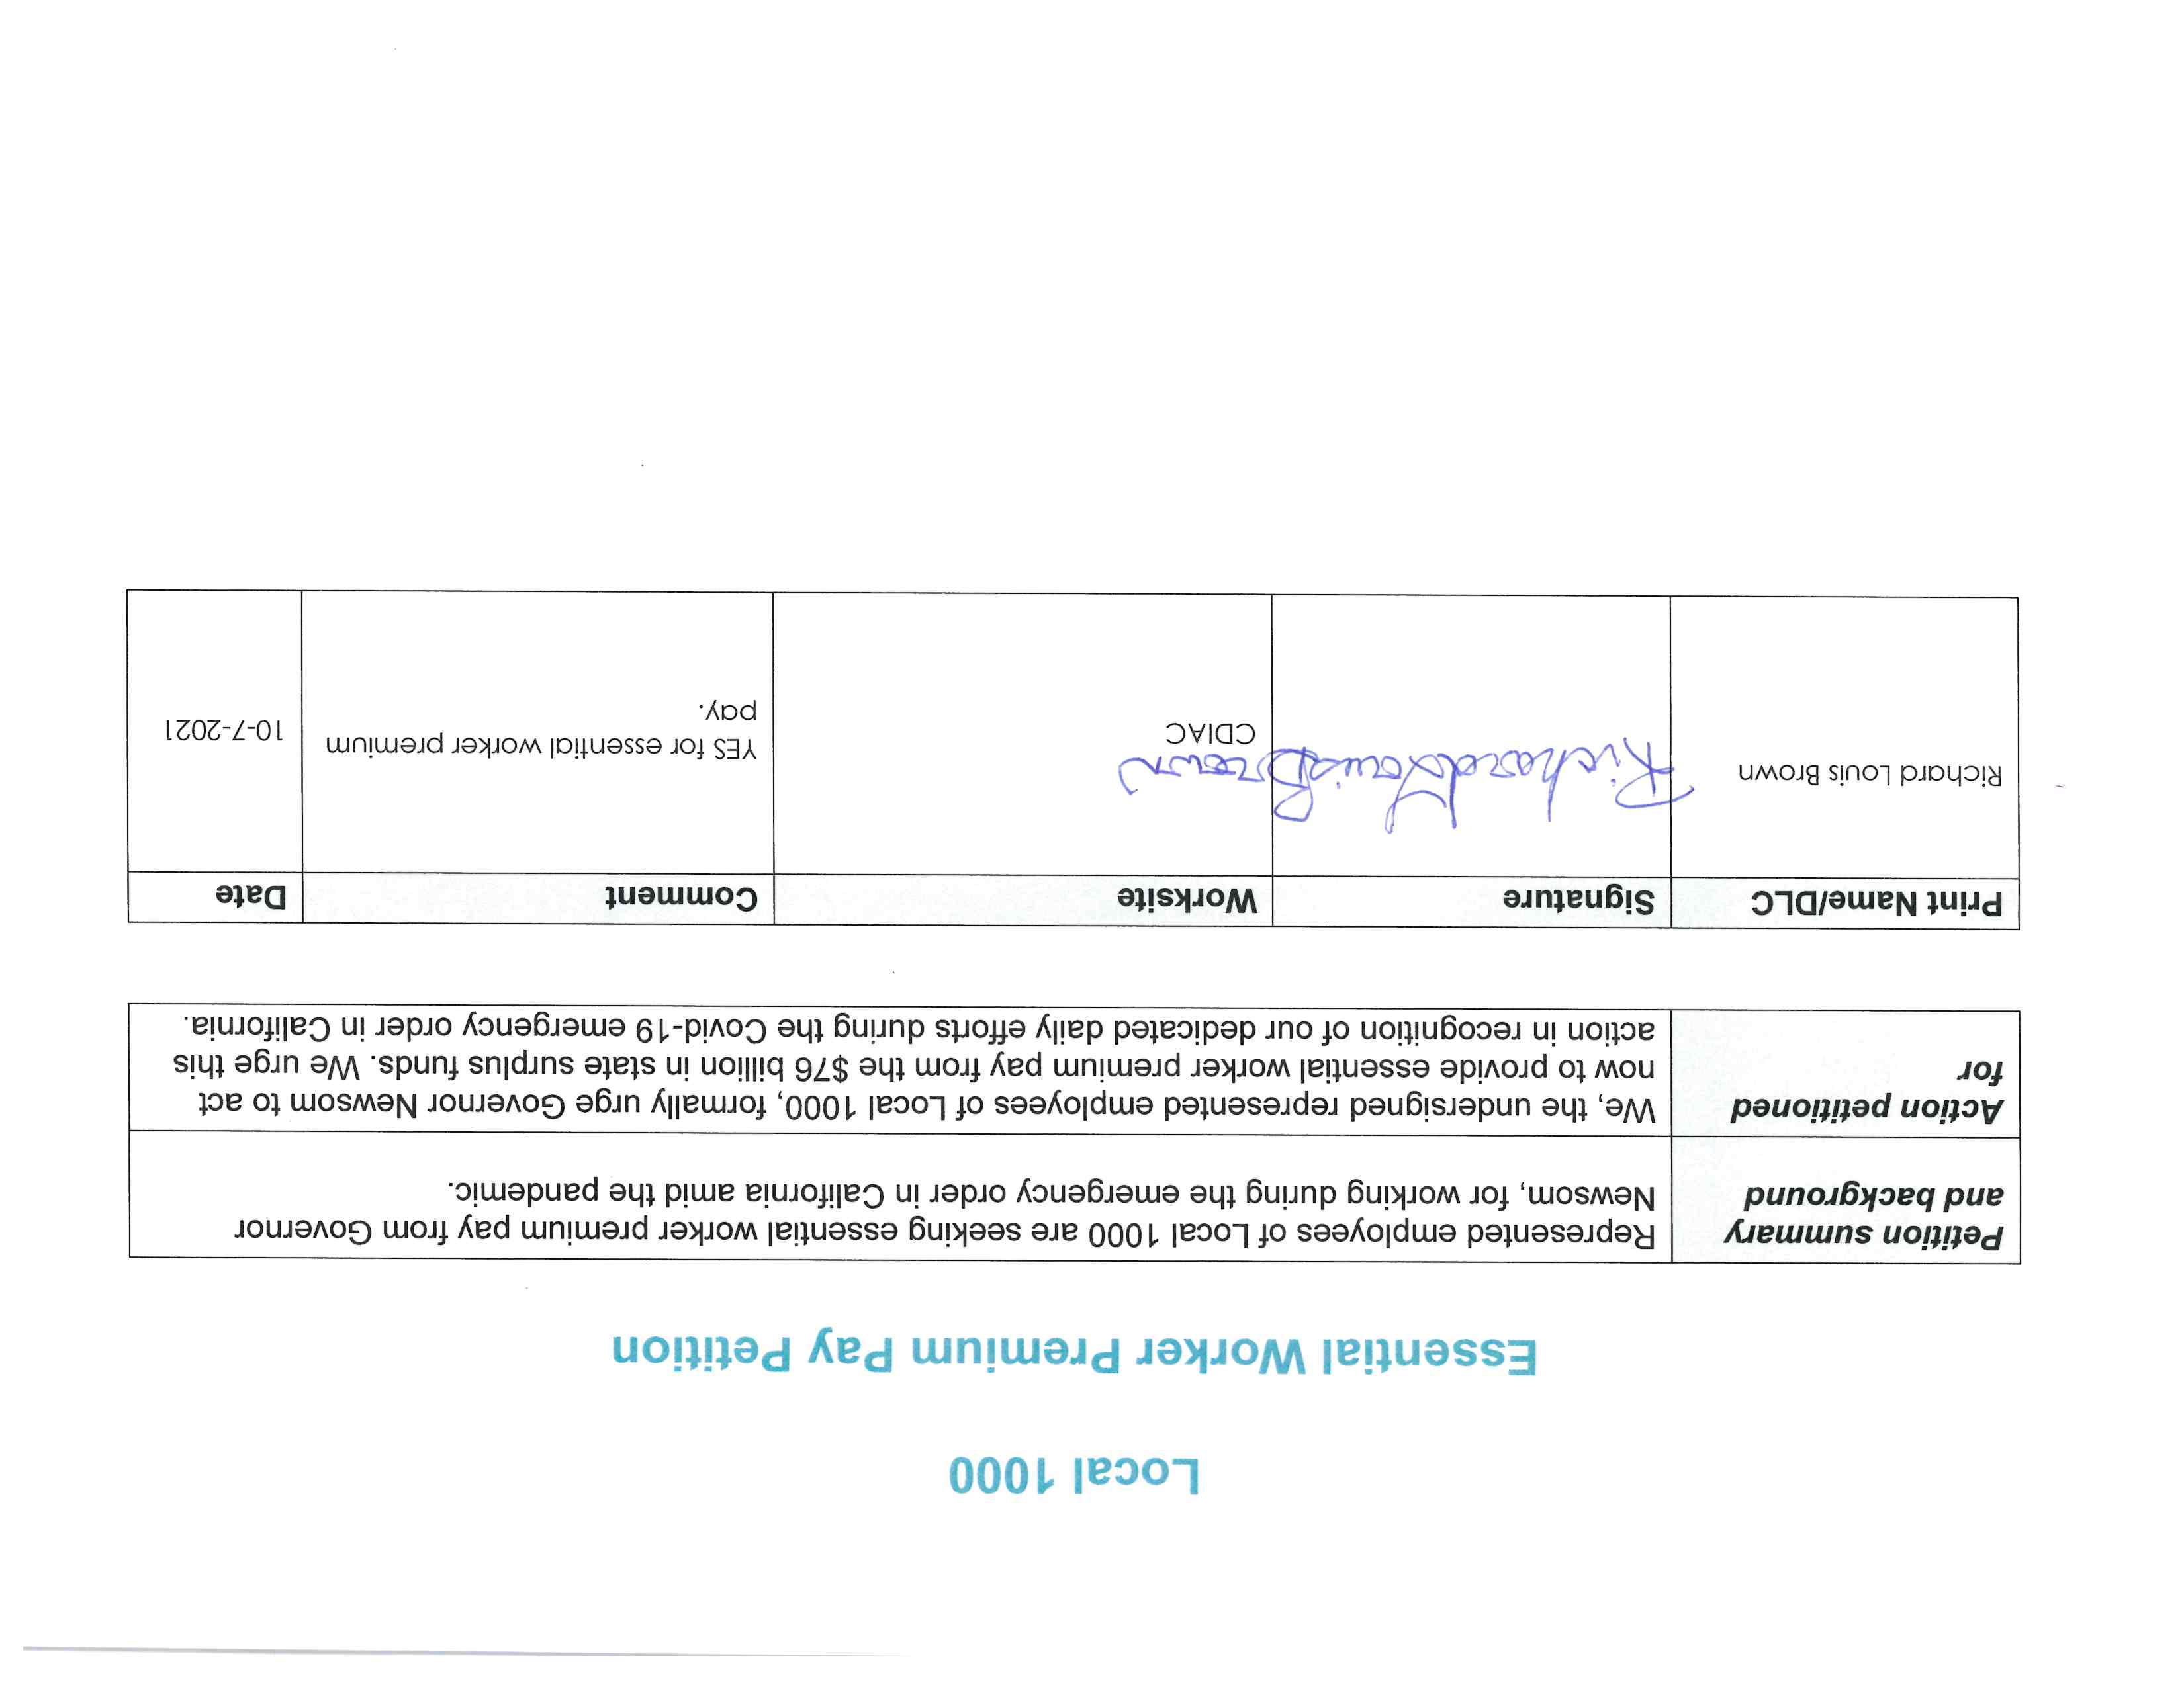

Slide 4
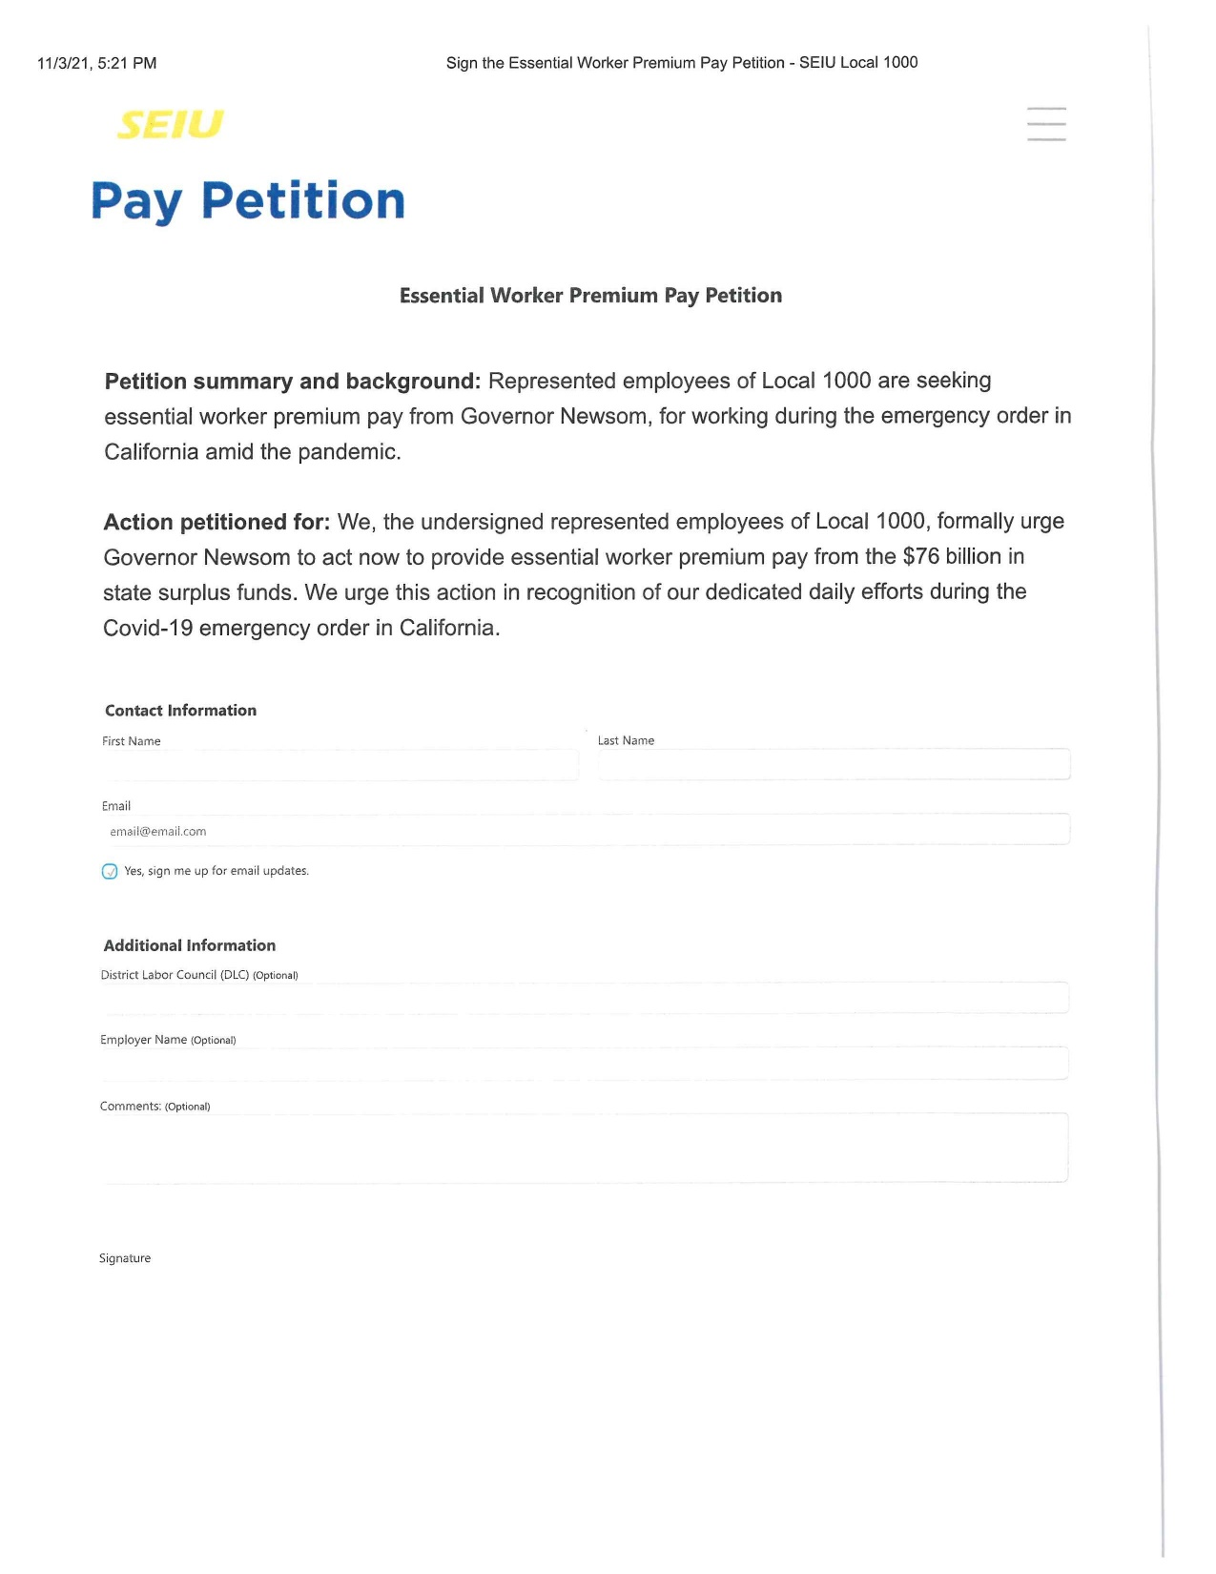

Slide 6
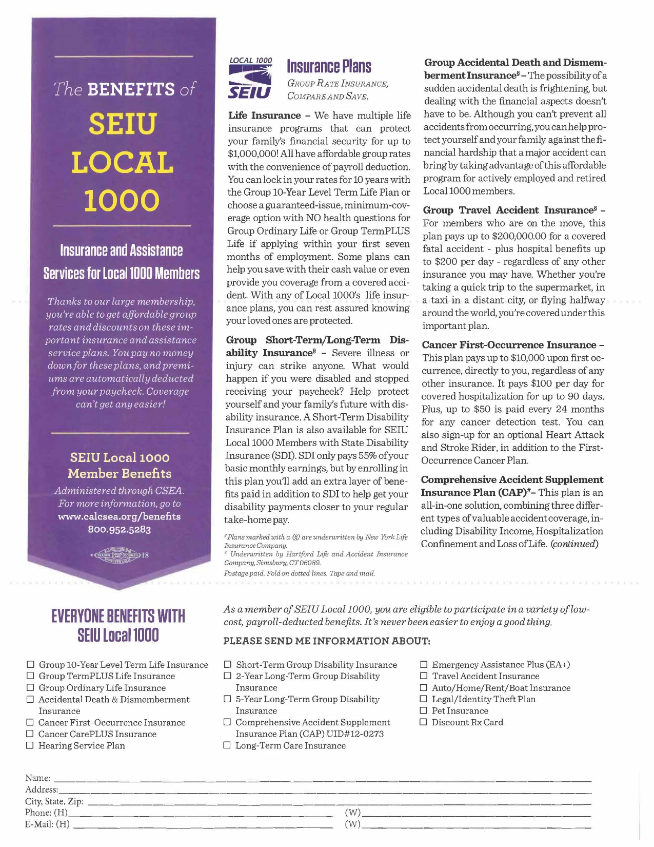

Slide 7
CSEA Member Benefits

Slide 9
0% interest

Slide 10
Pay over 18 months. Payroll deduction.

Slide 11
Gift now,
pay later
Exclusive voluntary benefit from California State Employees Association
Pay over 18 months — right from your paycheck.
Handbags as low as
$11/paycheck**
Hottest games, consoles, handhelds & more**
Sign up today and get
20% off*
your first order
Televisions as low as
$37/paycheck**
Phones as low as
$65/paycheck**
Be entered for a chance to win a
$2,000 Holiday Shopping Spree†
No credit check. No upfront payment.
No hidden fees.

Slide 12
Sign up today and get
20% off*
Shop now and pay over time — right from your paycheck.
Shop 40,000+ products
your first order
Promo code: HOLIDAY21
Be entered for a chance to win a
$2,000 Holiday Shopping Spree†
Buy computers, furniture, appliances and much
more – from all your favorite brands.
Pay over time–up to 18 months
Shop with no upfront payment and you’ll always know the total cost when you order.
Get it now, enjoy it now
Receive your order right away without turning to high-interest credit cards or rent-to-own.
Shop now
CSEA.PurchasingPower.com
or call 1-888-923-6236
PURCHASING POWER
Unlock your Spending Power! Sign up for free today.
If you would like to pay for your Dell purchase in cash, instead of using payroll deduction, you may receive a discount of 7% by calling Dell directly at 1-800-695-8133 or logging on to http://www.dell.com/eppbuy and entering Member ID: US43577519. This program is not affiliated with Purchasing Power and the current promo will not apply.
The Purchasing Power Program is endorsed by the California State Employees Association. You must be a member of one of CSEA’s Affiliates. You must have your CSEA Affiliate Member ID. Members may call Membership Division at 800-952-5283 for Member ID.
2727 Paces Ferry Road SE Building 2, Suite 1200
Atlanta, GA 30339
*Promo valid online only for 20% off through 12/12/2021 at 11:59pm PT. First time buyers only. Offer excludes Xbox Series X consoles, Xbox Series S consoles, PS5 consoles, Automotive, Vacations, Flooring and Allstate Protection Plans. Offer subject to change and/or end without notice. Go online to purchasingpower.com/exclusions for full details.
**Pricing is based upon 12 pay periods per year which may vary by customer. Products and pricing are available while supplies last and are subject to change without notice, so go online for the latest offering. Individual eligibility requirements and spending limits may apply.
†Restrictions apply visit https://www.purchasingpower.com/sweepstakes for official rules and complete details.
Sweepstakes ends 11/30/2021.
“Purchasing Power” is a registered trademark, of Purchasing Power, LLC. Other trademarks or registered trademarks used are the property of their respective owners. © 2021 Purchasing Power, LLC. All rights reserved.

Slide 13
Relax & Surf
Computers
as low as $21 / paycheck**
Furniture
as low as $66 / paycheck**

Slide 14
Appliances T.V.s
Refrigerators
as low as $61 / paycheck**
Televisions
as low as $12 / paycheck**

Slide 15
For more information www.calcsea.org Member Benefits 916-326-4283

Slide 16
From: Tracy McCabe <eastcoast7195@gmail.com>
Sent: Wednesday, October 27, 202110:48 AM
To: Brown, Richard <RLBrown@SEIU1000.org>; askRLB <askRLB@SEIU 1000.org>
Subject: Telework Stipend and overall comments
Hi Richard,
I wanted to reach out with some comments, hoping you will read this and that my opinion matters. First let me say, I believe I read somewhere you are prior military - thank you for your service to our country. Additionally, I think you are doing a fantastic job, in a very tough political climate. Change management is never easy, but please keep doing what you are doing. I do not support the conduct of those on the Board etc. who oppose you and therefore, feel it's okay to cause such mayhem, and act in such an extreme unprofessional manner. They do not represent all Union members with that anger fueled hate speech against you.
My comments with respect to Teleworking and the stipend are that I am hoping you continue to push for 100% remote work, for those who have positions that support working remotely. As for the telework stipend being negotiated, I am hoping you will not settle for the $50 some other Unions have settled for. I would not be happy with this, given the massive revenue reported by the Governor and the massive savings by not having office space overhead, with so many remote workers absorbing that on their end. My SMUD, PG&E, and Sacramento Water bills are higher than ever in the 20 years I have lived in this home. I do NOT have a department issued laptop nor cell phone, so had to purchase a work laptop and mouse at the onset of the pandemic, which requires annual anti-virus software renewal etc. Yes, we are all saving gas from not commuting, but overall, even Comcast has gone up this month, which I use at home for high speed Internet (rent modem/router) to VPN into work. I was told by Comcast, it's all for state and federal fees, almost $7 per month. I am often low on my Verizon data each month on my cell phone for using it for work. So, with saying all that, there are far beyond $50 per month expenses due to teleworking. And, I hope you will fight for the telework stipend to back date to March 2020. We deserve that.
I signed your petition for essential worker pay and really hope that is pushed for and back-dated to March 2020. I personally work long hours (OT) and did not even take a minute off the first 6 months of the pandemic. And then, it was only a sick day here and there, not much at all to-date. Things are busier than ever and state workers holding it all down should be considered by the Governor. He is dolling out millions to other segments of the California population, and has forgotten us completely.
Sorry to rant, but I love my job at DOJ, but it was a hit to lose 9.23% of my income for a year. I fully support you in demanding much more than $50 per month for a telework stipend. More like $250 or at least $150 per month seems fair. And, not to have it run through SCO, where it's taxed almost in half like the $260 healthcare stipend, where I take home roughly $162 per month after taxes. That is outrageous.
And please keep fighting for not having vaccine mandates. What a violation of my privacy. I reported "decline to state" and it was not popular to do so. I asked hard questions and seemed to be the only was on my team doing so.
Please keep doing what you are doing Richard! The change is needed in this state and Union. You have my full support.
Stay safe & take care,
Tracy McCabe, MPA 916-838-7900

Slide 17
From: S Cooper <sec95815@yahoo.com> Sent: Wednesday, October 27, 202110:47 AM To: askRLB <askRLB@SEIUlOOO.org>
Cc: sec95815@live.com
Subject: Petition for essential worker compensation
Richard,
I am not in agreement with the way you are going about this demand for essential worker pay. Granted my knowledge is limited to my scope of feedback and input. I work for DGS at the Ziggurat and we have been given tremendous latitude in finding our best, safe work environment. The vast majority of DGS workers are at some level of telework status. In such, even though we are considered essential workers, we have been allowed to stay safe and out of harm's way. This is contrary to the premise of essential worker hazard pay, which is intended for first responders, who put themselves in harms way.
Is there a reason why our union is not going back and seeking restoration of our income lost to the furlough program which was wrongly imposed on us.
State workers are sick and tired of being the first line of fiscal defense for the State of California.
With all the surplus, we partially provided through the 10% savings of the furlough program, the State should return to us the lost income of the
furloughs. The days we missed were not by choice but closer in nature to a work lock­ out, which we didn't want or ask for.
By the way, put the "No Furlough Clause" back into our contract.
Samantha Cooper
Sr Real Estate Officer
CA Dept. of General Services Asset Management Branch
1

Slide 18
First Name:
Steffanie
Last Name:
Nelson
Department:
CDCR
Personal Cell Phone Number*:
9162972857
Personal e-mail:
steff.nelson623@g maiI.com
Message:
Hi there, I just wanted to thank you all for doing the petition for us to get essential worker pay, 0 hope we get it.. especially considering that the State is buying Tesla's that are over $40,000 each for (at least) 6 prisons, just so the Warden's who make over $10,000 a month can drive them. I've heard that other State departments are also getting
these Tesla's. This sort of thing is frustrating as a State worker who has served CDCR Folsom State Prison correctional officers, executive, medical and free staff throughout the entire pandemic, making sure that their salaries, overtime, benefits and retirements were just right. Thank you for fighting for us.
Stay Connected*:
Keep me updated with periodic text updates
2

Slide 19
THE HATERS
Jonah Paul
November 2, 2021 at 1:31pm
527 Views as of 6:47am on November 3, 2021
I love 97.5. It's the best station for music in Sacramento, but it's not a politically neutral station. It is owned by the Black Chamber of Commerce who tend to (but not always) take political stances that I strongly disagree with as a union activist. When one scholar was invited on the air to speak about about one America's greatest labor leaders, A Philip Randolph, he was constantly talked over and interrupted by the host. I was so frustrated I had to call in to politely ask the host to let the man have a chance to get his opinion across. You have to look through the hype. He may have good intentions, but this is a stunt like all the rest.
2h Like Reolv

Slide 20
From: To:
Cc: Subject: Date:
phd@fastmail.com Brown, Richard
Walls, Anica; Francina Stevenson; SEIU 1000 Miguel Cordova
CHANCELLOR"S OFFICE UNION MEMBERS 100% BEHIND PRESIDENT BROWN
Wednesday, November 3, 2021 8:47:37 AM
Dear President Brown,
On Nov 1-2, 2021, I conducted a poll of SEIU1000 members who work at the Chancellor's Office of the California Community Colleges. We are under DLC 794. I am the only job steward at that job site.
Should the portion of the SEIU 1000 Board of Directors who are subverting President Richard Brown's reform agenda: 1) Stop their interference and 2) Respect the voting will of the members who elected President Brown to carry out the reforms he promised to enact?
YES = 100%
NO = 0%
Going forward should the DLC 794 President and Bargaining Unit Chair consult with union members on matters pending before the SEIU 1000 board, in order to get their advice on how to vote?
YES = 100%
NO = 0%
These results are consistent with those reported by DLC 785 President Wanda Yanez. She polled all nine of her stewards, and all nine did not support the effort to subvert your leadership and undo the will of the members who elected you.
Our job site plans to reach out to our DLC leadership, to request we be informed of board agendas in advance so that we can conduct similar polls, and then advise them how we believe they should vote.
With your permission I would like to briefly share these polling results at your meeting tonight, when it is my turn to speak during the open forum. I believe this is an essential model all DLC's should adopt---listen to the members, and do as they direct. (NOTE: I registered for tonight's meeting but so far I have not received a participation link).
Respectfully yours, Eric
Eric L. Nelson, Ph.D.

Slide 24
Thank you!

